Slide 1


Drazen Vorkapic
29/6/2025

Slide 2

Outline
Executive Summary
Introduction
Methodology
Results
Conclusion
Appendix

Slide 3
Executive Summary
Summary of methodologies
Summary of all results

Slide 4
Introduction
Project background and context
Problems you want to find answers

Slide 5

Section 1

Slide 6
Methodology
Executive Summary
Data collection methodology:
Request to SpaceX API
Perform data wrangling
Describe how data was processed
Perform exploratory data analysis (EDA) using visualization and SQL
Perform interactive visual analytics using Folium and Plotly Dash
Perform predictive analysis using classification models
How to build, tune, evaluate classification models

Slide 7
Data Collection
We collect data by request to SpaceX API and make sure the data is in the correct format
Request and parse the SpaceX launch data using the GET request
Decode the response content as a Json and turn it into a Pandas dataframe
Filter the dataframe to only include Falcon 9 launches
Find missing values
Replace missing values with mean

Slide 8
Data Collection – SpaceX API
Request and parse the SpaceX launch data using the GET request
decode the response content as a Json and turn it into a Pandas dataframe
Filter the dataframe to only include Falcon 9 launches
find missing values
replace missing values with mean
https://github.com/VDrazen/DSCapstoneApplied/blob/main/jupyter-labs-spacex-data-collection-api.ipynb

Slide 9
Data Collection - Scraping
web scraping to collect Falcon 9 historical launch records from a Wikipedia page
perform an HTTP GET method to request the Falcon9 Launch HTML page
Extract all column/variable names from the HTML table header
Create a data frame by parsing the launch HTML tables
https://github.com/VDrazen/DSCapstoneApplied/blob/main/jupyter-labs-webscraping.ipynb

Slide 10
Data Wrangling
Calculate the number of launches on each site
Calculate the number and occurrence of each orbit
Calculate the number and occurence of mission outcome of the orbits
Create a landing outcome label from Outcome column
https://github.com/VDrazen/DSCapstoneApplied/blob/main/labs-jupyter-spacex-Data%20wrangling.ipynb

Slide 11
EDA with Data Visualization
scatter plot of Flight Number vs. Launch Site
scatter plot of Payload vs.. Launch Site
relationship between success rate of each orbit type
relationship between FlightNumber and Orbit type
relationship between Payload Mass and Orbit type
launch success yearly trend
https://github.com/VDrazen/DSCapstoneApplied/blob/main/edadataviz.ipynb

Slide 12
EDA with SQL
unique launch sites in the space mission
launch sites begining with the string 'CCA'
total payload carried by boosters from NASA
average payload mass carried by booster version F9 v1.1
first successful landing outcome on ground pad
boosters which have successfully landed on drone ship and had payload mass > 4000 and <6000
total number of successful and failure mission outcomes
booster which have carried the maximum payload mass
failed landing_outcomes in drone ship, for in year 2015
https://github.com/VDrazen/DSCapstoneApplied/blob/main/jupyter-labs-eda-sql-coursera_sqllite.ipynb

Slide 13
Build an Interactive Map with Folium
all launch sites on a map
success/failed launches for each site on the map
distances between a launch site to its proximities
https://github.com/VDrazen/DSCapstoneApplied/blob/main/lab_jupyter_launch_site_location.ipynb

Slide 14
Build a Dashboard with Plotly Dash

Slide 15
Predictive Analysis (Classification)
logistic regression object then create a GridSearchCV object
support vector machine object
decision tree classifier object
k nearest neighbors object
https://github.com/VDrazen/DSCapstoneApplied/blob/main/SpaceX_Machine%20Learning%20Prediction_Part_5.ipynb

Slide 16
Results
Exploratory data analysis results
Interactive analytics demo in screenshots
Predictive analysis results

Slide 17

Section 2

Slide 18
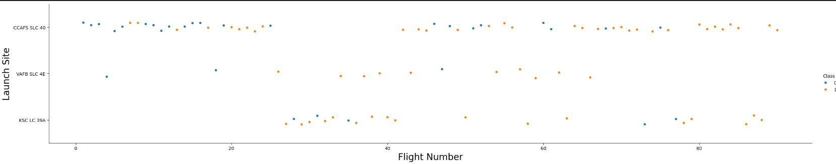
Flight Number vs. Launch Site
scatter plot of Flight Number vs. Launch Site

Slide 19
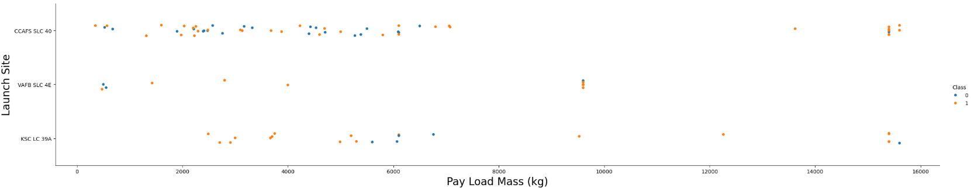
Payload vs. Launch Site
Show a scatter plot of Payload vs. Launch Site
scatter plot of Payload vs.. Launch Site

Slide 20
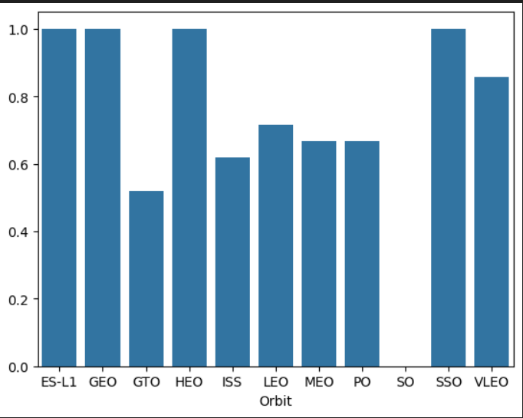
Success Rate vs. Orbit Type
relationship between success rate of each orbit type

Slide 21
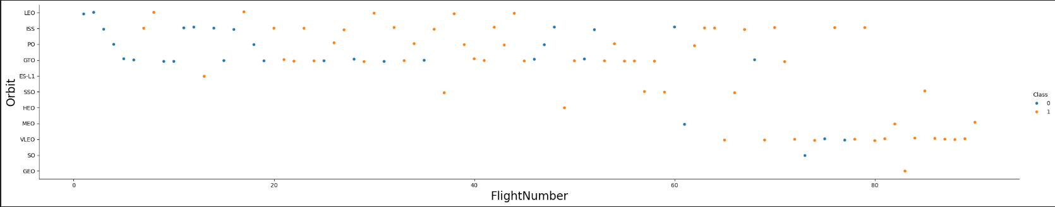
Flight Number vs. Orbit Type
relationship between FlightNumber and Orbit type

Slide 22
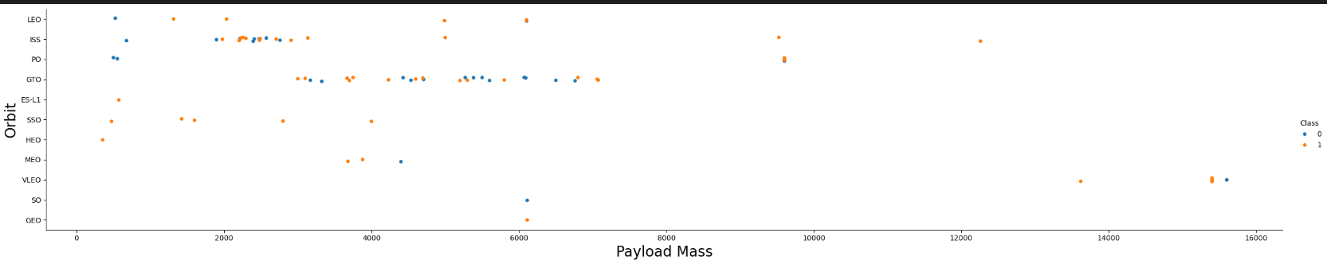
Payload vs. Orbit Type
relationship between Payload Mass and Orbit type

Slide 23
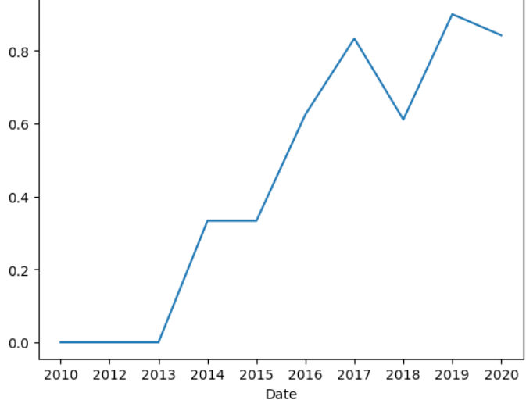
Launch Success Yearly Trend
launch success yearly trend

Slide 24
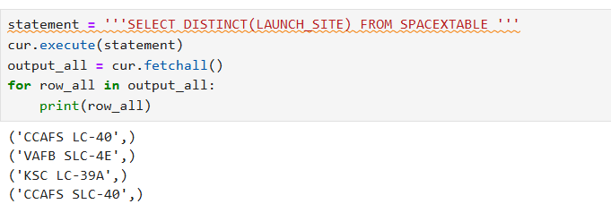
All Launch Site Names
unique launch sites in the space mission

Slide 25
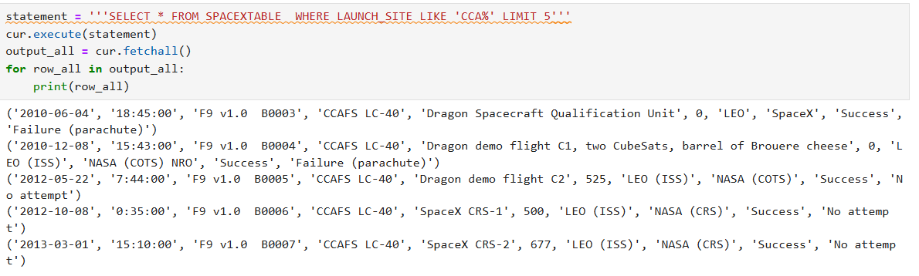
Launch Site Names Begin with 'CCA'
launch sites begining with the string 'CCA'

Slide 26
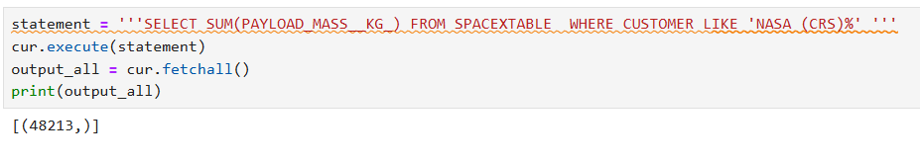
Total Payload Mass
total payload carried by boosters from NASA

Slide 27
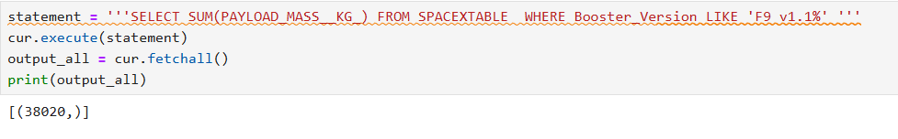
Average Payload Mass by F9 v1.1
average payload mass carried by booster version F9 v1.1

Slide 28
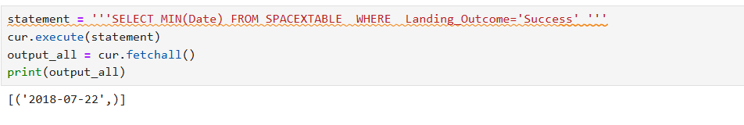
First Successful Ground Landing Date
first successful landing outcome on ground pad

Slide 29
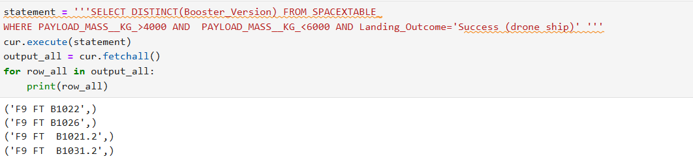
Successful Drone Ship Landing with Payload between 4000 and 6000
boosters which have successfully landed on drone ship and had payload mass greater than 4000 but less than 6000

Slide 30
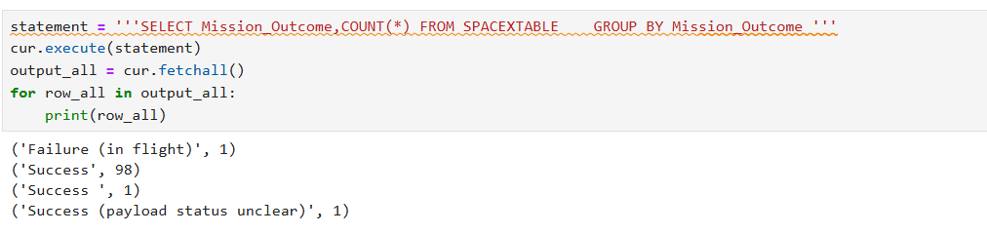
Total Number of Successful and Failure Mission Outcomes
total number of successful and failure mission outcomes

Slide 31
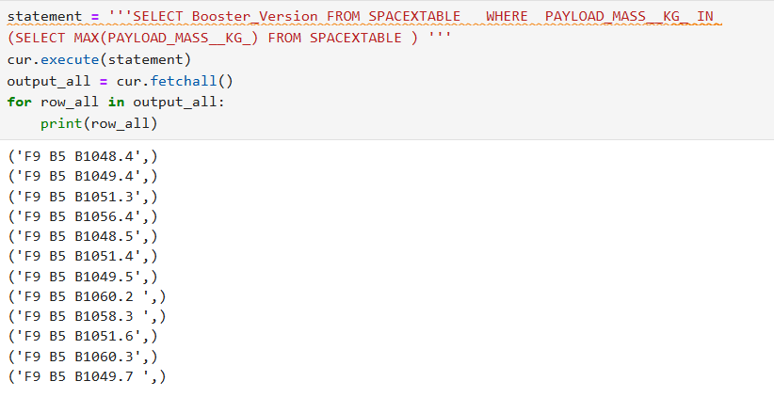
Boosters Carried Maximum Payload
booster which have carried the maximum payload mass

Slide 32
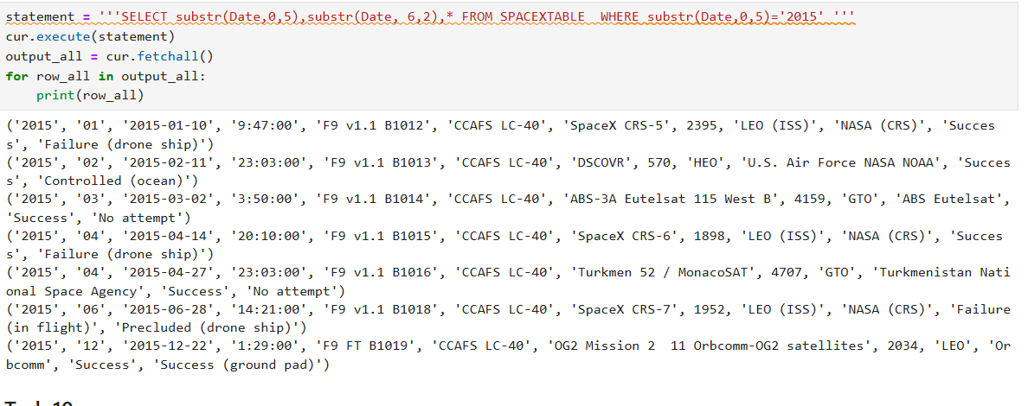
2015 Launch Records
failed landing_outcomes in drone ship, their booster versions, and launch site names for in year 2015

Slide 33
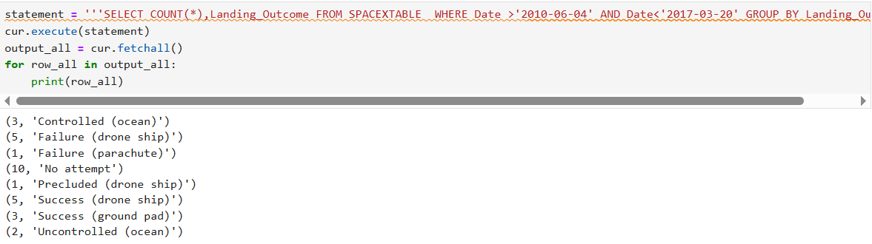
Rank Landing Outcomes Between 2010-06-04 and 2017-03-20
count of landing outcomes (such as Failure (drone ship) or Success (ground pad)) between the date 2010-06-04 and 2017-03-20, in descending order

Slide 34

Section 3

Slide 35
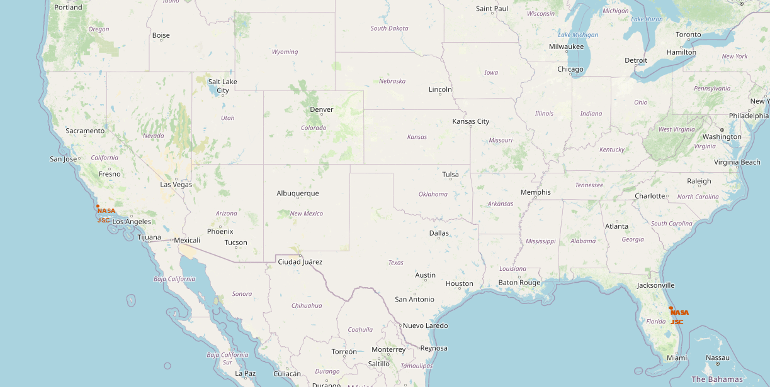
Launch sites
all launch sites on a map

Slide 36
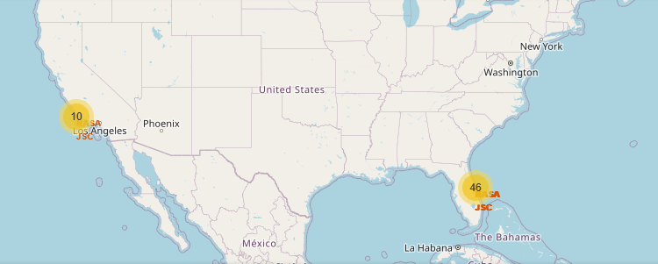
Success launches for each site
success/failed launches for each site on the map

Slide 37
<Folium Map Screenshot 3>
Replace <Folium map screenshot 3> title with an appropriate title
Explore the generated folium map and show the screenshot of a selected launch site to its proximities such as railway, highway, coastline, with distance calculated and displayed
Explain the important elements and findings on the screenshot

Slide 38

Section 4

Slide 39
<Dashboard Screenshot 1>
Replace <Dashboard screenshot 1> title with an appropriate title
Show the screenshot of launch success count for all sites, in a piechart
Explain the important elements and findings on the screenshot

Slide 40
<Dashboard Screenshot 2>
Replace <Dashboard screenshot 2> title with an appropriate title
Show the screenshot of the piechart for the launch site with highest launch success ratio
Explain the important elements and findings on the screenshot

Slide 41
<Dashboard Screenshot 3>
Replace <Dashboard screenshot 3> title with an appropriate title
Show screenshots of Payload vs. Launch Outcome scatter plot for all sites, with different payload selected in the range slider
Explain the important elements and findings on the screenshot, such as which payload range or booster version have the largest success rate, etc.

Slide 42

Section 5

Slide 43
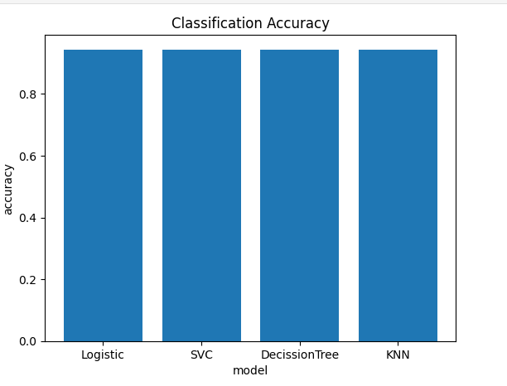
Classification Accuracy

Slide 44
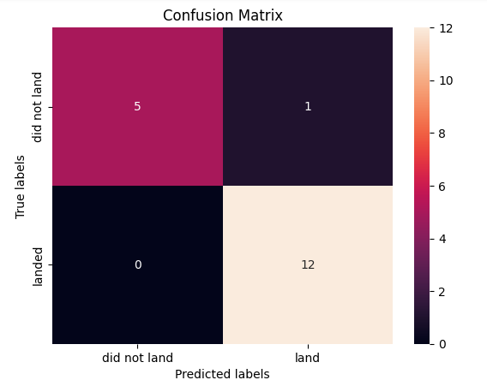
Confusion Matrix

Slide 45
Conclusions
Point 1
Point 2
Point 3
Point 4
…

Slide 46
Appendix
Include any relevant assets like Python code snippets, SQL queries, charts, Notebook outputs, or data sets that you may have created during this project

Slide 47


